Slide 1
Java 8 (Concise Version , to simplify programming, more functionality in less coding )
Features
1. Lambda Expression(To enable functional programming)
2. Functional Interfaces( which can be used to call lambda expression )
3. Default methods in interfaces (we can write only abstract methods inside interfaces till 1.7 version ,& variable public static final but u can declare concrete methods also inside interface called default methods )
4. Static methods in interfaces (Static functions inside interfaces in java 1.8 )
5. Predicate
6. Function
7. Consumer ( 5,6,7 are predefined functional interfaces)
8. Method reference & constructor reference By double colon(::) operator
9.Stream ApI (to perform bulk operation on collections) .
10. Date & Time Api (JODA API)
* Lambda & stream API are 2 very imp concepts

Slide 2
Java Versions
java 1.0 major version.
Java 1.1 minor version
Java 1.2 Major version (released collection framework feature in thisversion. )
Java 1.3, 1.4 minor version
Java 1.5 Major version (Generics , Autoboxing , unboxing , Enum supported in this version.)
Java 1.6, 1.7 minor version
Java 1.8 Major version(functional programming & parallel processing(to run on multi-core processor ) enabled )

Slide 3
Lambda expression
Java is recent/last language to start using lambda expression in java
In 1930s lambda expression came into picture & used heavily in calculus to solve heavy bigger bigger problem.
Lisp is the first programming started using lambda . Now c , C++, Ruby, Scala, python are all already started using this. Java is almost last to adapt this.

Slide 4
Why do we need of lambda
To enable functional programming in java(which is oops) (U can send procedural/function as a argument ).To get functional programming benefits in java we use lambda in java
To write more readable maintainable and consiseable code .
To use API easily & affectively u can use lambda expression.
To enable parallel processing .

Slide 5
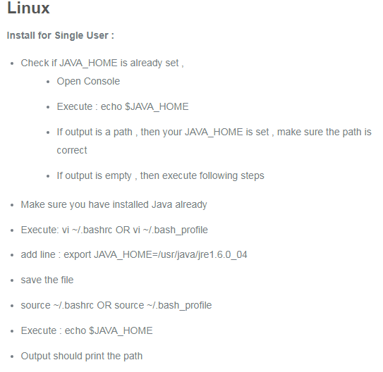
Installation Java 8
follow this tutorial https://www.thegeekstuff.com/2017/06/java-8-jre-jdk-install/
In case of this error ((can't create transaction lock on /var/lib/rpm/.rpm.lock (Permission denied)
sudo rpm -ivh yum.3.2.0-40-el6.centos.noarch.rpmRun echo $JAVA_HOME & find the java path .
sudo update-alternatives --config java then& done https://aboullaite.me/switching-between-java-versions-on-ubuntu-linux/
https://docs.opsgenie.com/docs/setting-java_home

Slide 6
Java 8 Stream
Java provides a new additional package in Java 8 called java.util.stream. This package consists of classes, interfaces and enum to allows functional-style operations on the elements. You can use stream by importing java.util.stream package.
Stream provides following features:
No storage. A stream is not a data structure that stores elements; instead, it conveys elements from a source such as a data structure, an array, a generator function, or an I/O channel, through a pipeline of computational operations.
Functional in nature. An operation on a stream produces a result, but does not modify its source. For example, filtering a Stream obtained from a collection produces a new Stream without the filtered elements, rather than removing elements from the source collection.
Laziness-seeking. Many stream operations, such as filtering, mapping, or duplicate removal, can be implemented lazily, exposing opportunities for optimization. For example, "find the first String with three consecutive vowels" need not examine all the input strings. Stream operations are divided into intermediate (Stream-producing) operations and terminal (value- or side-effect-producing) operations. Intermediate operations are always lazy.
Possibly unbounded. While collections have a finite size, streams need not. Short-circuiting operations such as limit(n) or findFirst() can allow computations on infinite streams to complete in finite time.
Consumable. The elements of a stream are only visited once during the life of a stream. Like an Iterator, a new stream must be generated to revisit the same elements of the source.

Slide 7
Streams can be obtained in a number of ways. Some examples include:
From a Collection via the stream() and parallelStream() methods;
From an array via Arrays.stream(Object[]);
From static factory methods on the stream classes, such as Stream.of(Object[]), IntStream.range(int, int) or Stream.iterate(Object, UnaryOperator);
The lines of a file can be obtained from BufferedReader.lines();
Streams of file paths can be obtained from methods in Files;
Streams of random numbers can be obtained from Random.ints();
Numerous other stream-bearing methods in the JDK, including BitSet.stream(), Pattern.splitAsStream(java.lang.CharSequence), and JarFile.stream().
Generating Streams
With Java 8, Collection interface has two methods to generate a Stream.
stream() − Returns a sequential stream considering collection as its source.
parallelStream() − Returns a parallel Stream considering collection as its source.
List<String> strings = Arrays.asList("abc", "", "bc", "efg", "abcd","", "jkl");
//get count of empty string
long count = strings.parallelStream().filter(string -> string.isEmpty()).count();

Slide 8
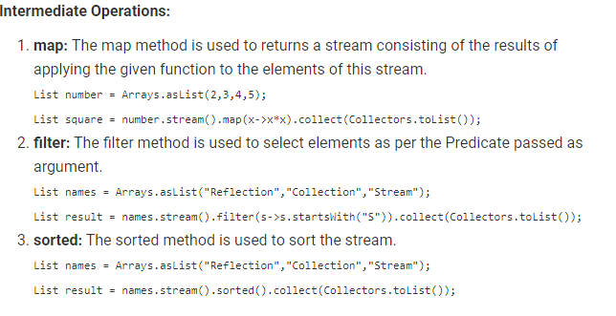
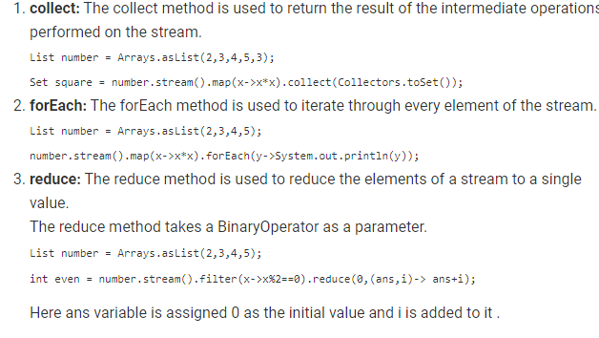
Terminal Operations:

Slide 9
Stream operations and pipelines
Stream operations are divided into intermediate and terminal operations, and are combined to form stream pipelines. A stream pipeline consists of a source (such as a Collection, an array, a generator function, or an I/O channel); followed by zero or more intermediate operations such as Stream.filter or Stream.map; and a terminal operation such as Stream.forEach or Stream.reduce.
Intermediate operations return a new stream. They are always lazy; executing an intermediate operation such as filter() does not actually perform any filtering, but instead creates a new stream that, when traversed, contains the elements of the initial stream that match the given predicate. Traversal of the pipeline source does not begin until the terminal operation of the pipeline is executed.
Terminal operations, such as Stream.forEach or IntStream.sum, may traverse the stream to produce a result or a side-effect. After the terminal operation is performed, the stream pipeline is considered consumed, and can no longer be used; if you need to traverse the same data source again, you must return to the data source to get a new stream. In almost all cases, terminal operations are eager, completing their traversal of the data source and processing of the pipeline before returning. Only the terminal operations iterator() and spliterator() are not; these are provided as an "escape hatch" to enable arbitrary client-controlled pipeline traversals in the event that the existing operations are not sufficient to the task.

Slide 10
Processing streams lazily allows for significant efficiencies; in a pipeline such as the filter-map-sum example above, filtering, mapping, and summing can be fused into a single pass on the data, with minimal intermediate state. Laziness also allows avoiding examining all the data when it is not necessary; for operations such as "find the first string longer than 1000 characters", it is only necessary to examine just enough strings to find one that has the desired characteristics without examining all of the strings available from the source. (This behavior becomes even more important when the input stream is infinite and not merely large.)
Intermediate operations are further divided into stateless and stateful operations. Stateless operations, such as filter and map, retain no state from previously seen element when processing a new element -- each element can be processed independently of operations on other elements. Stateful operations, such as distinct and sorted, may incorporate state from previously seen elements when processing new elements.
Collectors
Collectors are used to combine the result of processing on the elements of a stream. Collectors can be used to return a list or a string.

Slide 11
Progam to Convert array to stream
public static void main(String[] args) {
String[] array = {"a", "b", "c", "d", "e"};
//Arrays.stream
Stream<String> stream1 = Arrays.stream(array);
stream1.forEach(x -> System.out.println(x));
//Stream.of
Stream<String> stream2 = Stream.of(array);
stream2.forEach(x -> System.out.println(x));
}
}

Slide 12
https://www.mkyong.com/java8/java-8-flatmap-example/
https://www.mkyong.com/java8/java-8-convert-a-stream-to-list/
https://www.mkyong.com/java8/java-how-to-convert-array-to-stream/
https://www.mkyong.com/java8/java-8-stream-read-a-file-line-by-line/

Slide 13
A Java lambda expression is thus a function which can be created without belonging to any class. A Java lambda expression can be passed around as if it was an object and executed on demand.
Java lambda expressions are commonly used to implement simple event listeners / callbacks, or in functional programming with the Java Streams API.
. It is very useful in collection library. It helps to iterate, filter and extract data from collection.
The Lambda expression is used to provide the implementation of an interface which has functional interface. It saves a lot of code. In case of lambda expression, we don't need to define the method again for providing the implementation. Here, we just write the implementation code.
Java lambda expression is treated as a function, so compiler does not create .class file.
Functional Interface
Lambda expression provides implementation of functional interface. An interface which has only one abstract method is called functional interface. Java provides an anotation @FunctionalInterface, which is used to declare an interface as functional interface.

Slide 14
Why use Lambda Expression
To provide the implementation of Functional interface.
Less coding.
Java Lambda Expression Syntax
(argument-list) -> {body}
Java lambda expression is consisted of three components.
1) Argument-list: It can be empty or non-empty as well.
2) Arrow-token: It is used to link arguments-list and body of expression.
3) Body: It contains expressions and statements for lambda expression.
https://www.javatpoint.com/java-lambda-expressions

Slide 15
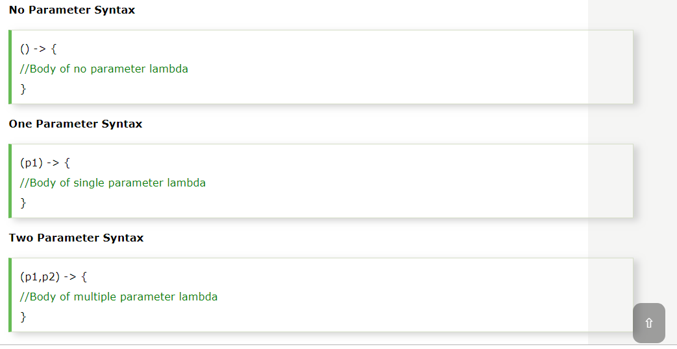

Slide 16
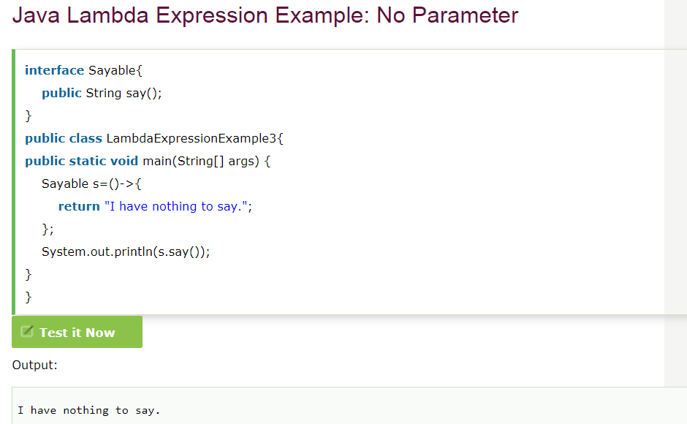

Slide 17
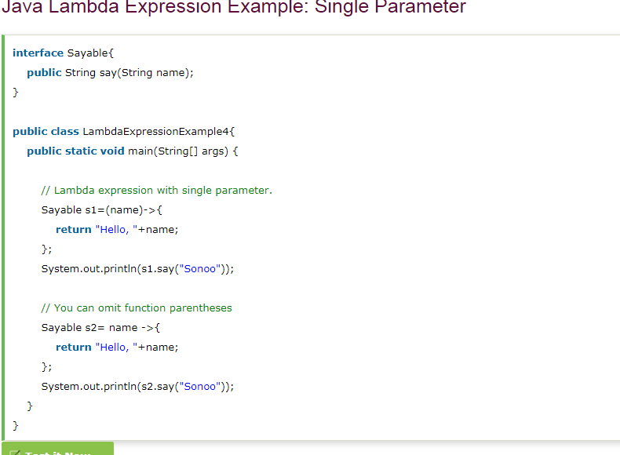

Slide 18
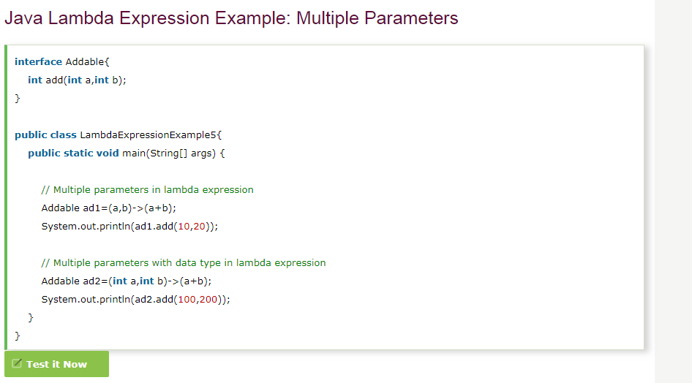

Slide 19
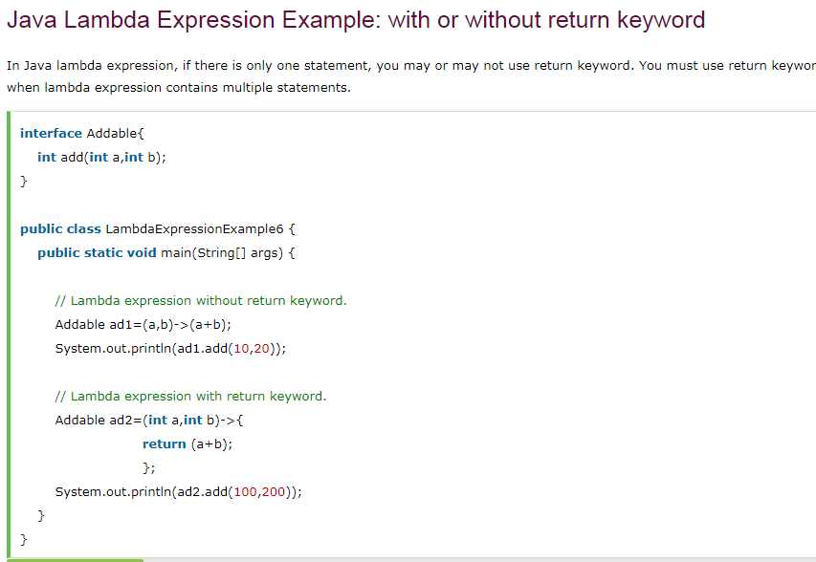

Slide 20
